Slide 1

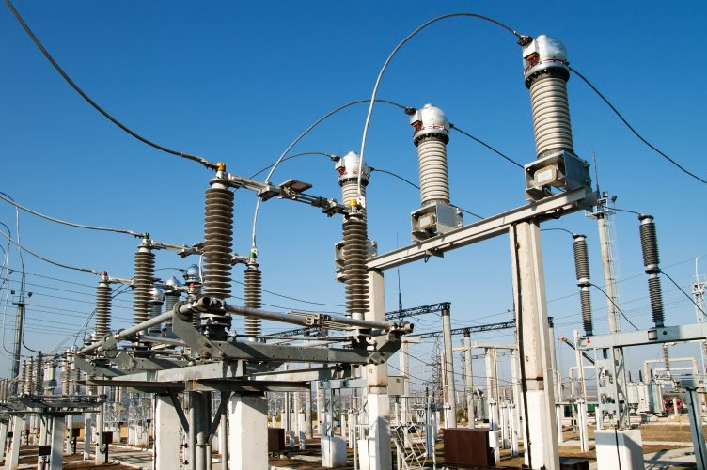

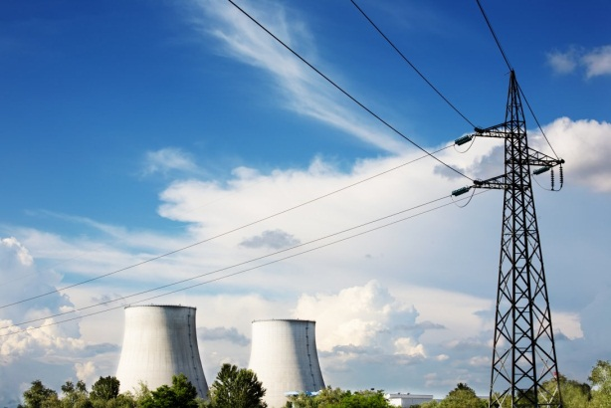

Post 2020 framework in a liberalised electricity market with large share of Renewable Energy Sources
(Market4RES)
GRANT AGREEMENT IEE/13/593/ SI2.674874
DURATION: April 2014 - September 2016 (M30)
BUDGET: 2.4 M EUR
Photos: Shutterstock, KeyTex
IEE-Market4RES project slides 2014-04-24

Slide 2

The liberalised electricity market
should ensure:
Efficient operation
Facilitate cross-border trade across Europe
Promote efficient investments
Level playing field for different generation sources
Effective risk management
Robustness
(Oxford Institute for Energy, M. Keay)

Slide 3
The EU Target Model
Target Model (TM) expected to be fully implemented by 2015
-including day-ahead price coupling,
- cross-borders intraday continuous trading and
- long-term cross-border capacity allocation with harmonized rules at European scale.
It is based in two main principles
Energy only regional markets (no capacity markets or capacity incentives-payments)
Market Coupling linking zonal day-ahead spot markets into a virtual market, where only congestion constrains limit trade
Fit for purpose ?
(Oxford Institute for Energy, M. Keay)

Slide 4

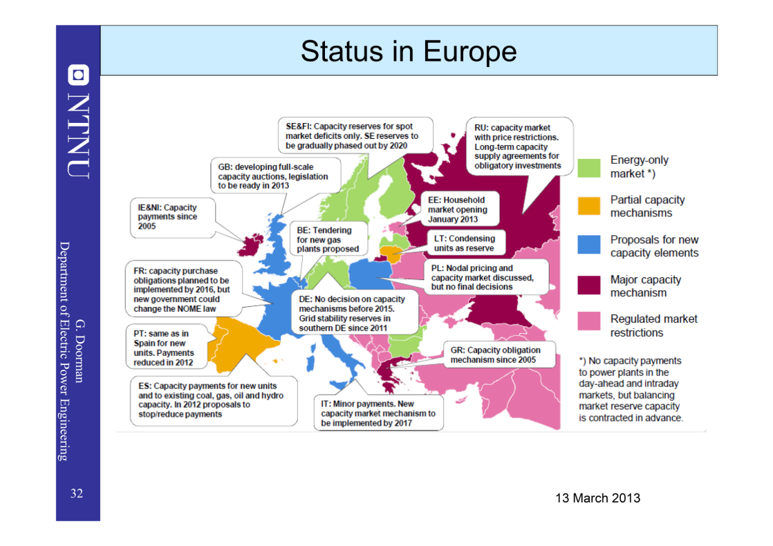
Capacity Markets
Pan - EU Market Coupling
Capacity Markets
Pan - EU Market Coupling

Slide 5
The Market4RES project objectives
IEE-funded project Market4RES investigates the potential evolution of the EU Target Model in order to secure the European power system decarbonisation with large amounts of renewables.
The project aims to:
Contribute to an open and transparent debate on the potential evolution of the EU Target Model after 2020 with the RES/GHG/EE 2030 targets in mind & large shares of
RES-e & large amounts of renewables
Identify and recommend steps for the implementation of policy, legislation and regulation across the renewable energy sectors.
Identify and recommend concrete steps so relevant market actors can accept and adopt the main results of the project.

Slide 6
Expected Impacts
Project within 2013 IEE priorities of the key action RES-Electricity - Strategic initiatives.
Strategic initiatives: Key objective is on facilitating the dialogue among relevant stakeholders.
The project should effectively contribute and ensure an open and transparent debate to achieve the 'potential evolution of the EU Target Model after 2020'. The implementation of the TM has already started at national, regional and European level.
Under IEE programme , a successful project must actively involve the relevant market actors in the field, committed to adopting/implementing the results of the project, i.e. recommendations for implementation of new policy, legislation and regulation across the renewable energy sectors.

Slide 7













Slide 8
Government | Scottish Government | Scottish Govt
 | Instituto para la Diversificación y Ahorro de la Energía – Spanish Government | IDAE
 | German Energy Agency – Dena | DENA
 | Norwegian Energy Agency | ENOVA
Regulators | Energie-Control Austria | E-CONTROL
TSO | CORESO | CORESO
 | European Network of Transmission System Operators for Electricity | ENTSO-E
 | Danish transmission system operator | ENERGINET.DK
 | Finnish transmission system operator | FINGRID
 | Belgian transmission system operator | ELIA
 | Spanish transmission system operator | REE
 | German transmission system operator | TenneT GmbH
RES Utility | Danish Wind Energy Association (Denmark) | DWIA
Traders & Markets | European Federation of Energy Traders | EFET
 | European Power Exchange | EPEXSPOT
 | Iberian Market Operator | OMIE
 | Independent energy trading company | NEAS Energy
ADVISORY BOARD COMPOSITION

Slide 9

Coordinator
Daniel Huertas-Hernando
Daniel.Huertas.Hernando@sintef.no
SINTEF Energy Research
Sem Sælands vei 11
NO-7465, Trondheim, Norway

