Slide 1
Market4RES –the policy framework
Oyvind Vessia and Joachim Balke
Renewables and CCS policy
DG ENERGY, Unit C.1
Energy

Slide 2
Content:
2030 Framework
RES support scheme reform & market integration

Slide 3
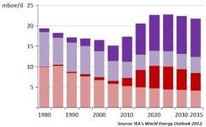
Climate and energy: where do we stand?
Renewable energy saw rapid cost decreases
Technologies are gradually becoming competitive
Impact of the financial crisis
Fall in private investment, tight financing conditions
Shale gas
US oil and gas production
Review of nuclear policies
at national level
Rising demand
-> rising prices
By 2030, world economy
set to double and energy demand to rise by 1/3
Unconventional gas
Unconventional oil
Conventional gas
Conventional oil
Notes:
Although it's only five years since the adoption of the climate and energy package in 2009, much have changed:
Financial crisis […]
Shale gas […]
Increasing fossil fuel prices […]
The Fukushima accident in Japan […]
Renewable energy has developed rapidly, and costs have come down, in particular PV, which is now 70% cheaper than for 7 years ago.

Slide 4
GHG target
RES target
EE
Between 35% and 45%
Up to 35%
Moderate, ambitious and very ambitious energy efficiency policies
Additional indicators / aspirational objectives
competitiveness and security of supply
Policy options and sub-options

Slide 5
Impacts of scenarios with 40% GHG reduction Overall share of RES in final energy consumption and share of RES in electricity

Slide 6
2030 climate and energy Framework
20 % GHG
≥ 20% RES
20 % EE
2020
40 % GHG
≥ 27 % RES
New Key Indicators
2030
..2014
New governance system

Slide 7
2030 Framework: New Governance System National plans for competitive, secure and sustainable energy
Commission details guidance on the new governance process and contents of national plans
Member States prepare plans based on an iterative process
Commission assess Member States' plans and commitments
Include objectives on:
non-ETS GHG emissions
renewable energy
energy savings
energy security
….

Slide 8
Main challenges…
Energy costs
Additional investments to achieve 2030 framework
Differences between Member States
Increasing in any event: renew ageing energy system, rising fossil fuel prices, meeting the climate and energy targets already agreed upon
Shift away from fuel expenditure towards investments, additional € 38 billion investment/year 2011-2030 compared to the reference scenario
Future discussion will have to be centred on how to ensure an equitable burden sharing affordable for all
Notes:
The Impact Assessment published along this Communication try to shed the light, analysing different possible scenarios, on what could be the implications, also at Member State level, of the adoption of the agreed 2030 framework.
The 2030 Framework will heavily depend on a strengthen governance system in which Member States will have to define their own national plans for competitive, secure and sustainable energy. These plans, that will have to be operational before 2020, will clarify Member States' strategies to achieve domestic objectives regarding non-ETS GHG emissions, renewable energy, energy savings, energy security and other important choices such as nuclear energy, shale gas, carbon capture and storage, interconnections as well a transition towards less carbon intensive fuels.
As long as these plans will not be further detailed by Member States and agreed by the Commission in the iterative process, it is therefore impossible to run a detailed assessment the implications of the new framework in term of costs and investments at Member State level.
Cost efficient implementation sees additional energy system costs increase by 0.15% by 2030.
Investments increase per annum by €38 billion (2011-2030).
Costs and investments relatively higher in lower income Member States.
For instance countries with a GDP below 90% of the EU average see higher than average increases in investments, equivalent to some €3 billion per annum (2011-2030).
Need to take into account of distributional factors
Address the investment challenge through solutions that contribute to improved finance.

Slide 9
Conclusions of the European Council
(20/21 March)
Decision on 2030 Climate and Energy Framework postponed to October meeting, but confirmed in line with 2050 objectives.
Commission asked to develop interconnection targets and an in-depth study of EU energy security and a comprehensive plan for the reduction of EU energy dependence by June 2014.

Slide 10
Content:
2030 Framework
RES support scheme reform & market integration

Slide 11
RES support scheme reform – first steps towards market integration
Support scheme guidance and EEAG establish important principles of RES market integration
Competitive determination of support level
Integration in short-term markets (DA/balancing)

Slide 12
Competitive determination of support level
"target model" envisages competitive determination of support level
Auctions for price based support
Quota systems
In principle competition for support between technologies
Convergence of price finding mechanism rather than total level of support

Slide 13
Integration in short term markets
Obligation to self-marketing (wholesale market integration)
Imposition of balancing responsibility
Small installations excepted (aggregation models to be developed)
Removal of incentive to produce under negative prices

Slide 14
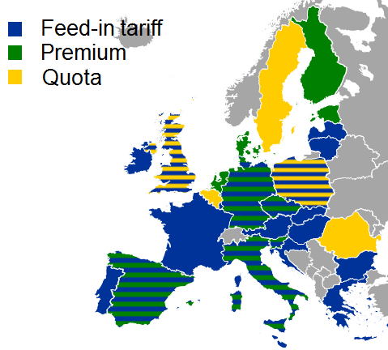
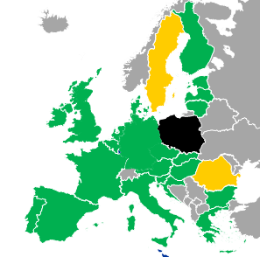
Towards convergence (RES guidance and EEAG) - structures
?

Slide 15
Conclusion on support scheme reform
Support scheme reform will lead to integration of RES in short term markets (operational efficiency)
BUT: investment decisions will continue to be determined to a large extent by government intervention
question: how to bridge the gap towards phasing out of support schemes?

Slide 16
Phasing out of support schemes for mature RES
The 2030 Communication states:
"As such, subsidies for mature energy technologies, including those for renewable energy, should be phased out entirely in the 2020-2030 timeframe. Subsidies for new and immature technologies with significant potential to contribute cost-effectively to renewable energy volumes would still be allowed."

Slide 17
Maturity reached on LCOE level, but …

Slide 18
Can (current) IEM sustain mature RES?
Preconditions:
Flexibility valued properly
Liquid short-term markets
Removal of price caps
Demand response enabled
Interconnection…
Some questions:
Revenue streams sufficient?
Wholesale/MO effect
ETS
Ancillary services
vRES undermining own business case?
RES capital structure and bankability?

Slide 19
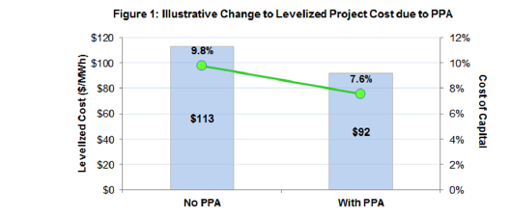
Impact of cost of capital on LCOE
Will RES move away from competitiveness with removal of support?
Source: Brattle Group, The importance of long-term contracting for facilitating renewable energy project development

Slide 20
Tentative conclusions
Support scheme reform ensures progress towards operational efficiency
New marketing models to emerge
But significant questions remain on RES in post-support scheme world
Capital intensity and costs of capital
Merit order effect
Market models emerging that provide stable revenue stream needed (long-term)?

Slide 21
Thank you for your attention!
More information available under:
http://ec.europa.eu/energy/
Guidance on public intervention:
http://ec.europa.eu/energy/gas_electricity/internal_market_en.htm

