Slide 1




Post 2020 framework in a liberalised electricity market with large share of Renewable Energy Sources
(Market4RES)
Daniel Huertas-Hernando
Daniel.Huertas.Hernando@sintef.no www.sintef.no/energy
Photos: Shutterstock, KeyTex
Stakeholder Kick-off Workshop, IEE-Market4RES, 2014-04-28

Slide 2


The liberalised electricity market
should ensure:
Efficient operation
Facilitate cross-border trade across Europe
Promote efficient investments
Level playing field for different generation sources
Effective risk management
Robustness (Oxford Institute for Energy, M. Keay)

Slide 3
The EU Target Model
Target Model (TM) expected to be fully implemented by 2015
    including day-ahead price coupling
    cross-borders intraday continuous trading and
    long-term cross-border capacity allocation with harmonized rules at European scale.
The Target Model is based in two main principles
Energy only regional markets
Market Coupling linking zonal day-ahead spot markets into a virtual market, where only congestion-constrains limit the trade
Fit for purpose ?
(Oxford Institute for Energy, M. Keay)

Slide 4

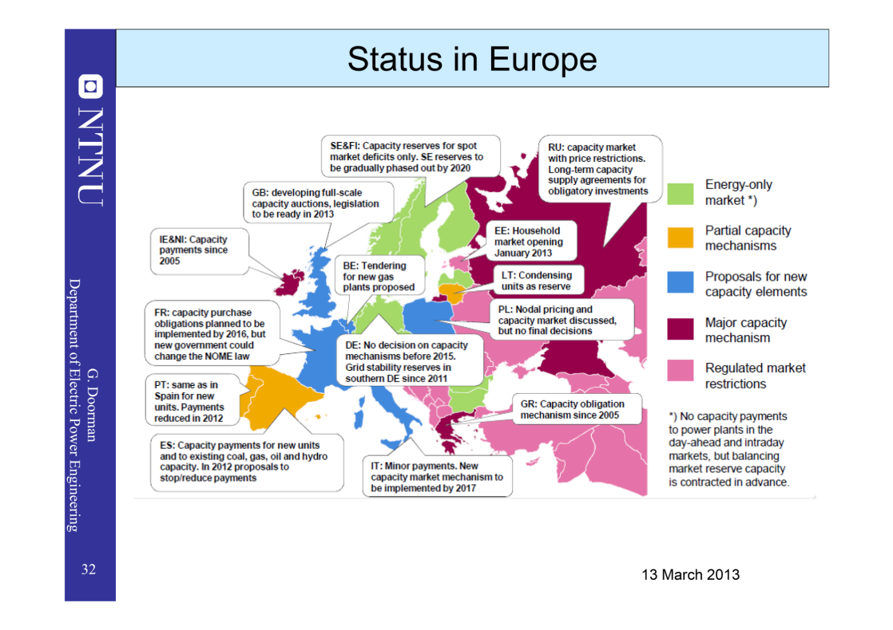
Capacity Markets
Pan - EU Market Coupling
Capacity Markets
Pan - EU Market Coupling

Slide 5
The Market4RES project objectives
In April 2014, the IEE-funded project Market4RES started investigating the potential evolution of the EU Target Model necessary to secure the European power system decarbonisation with large amounts of renewables.
The project aims to:
Contribute to an open and transparent debate on the potential evolution of the EU Target Model after 2020 with the RES/GHG/EE 2030 targets in mind & large shares of
RES-e & large amounts of renewables
Identify and recommend steps for the implementation of policy, legislation and regulation across the renewable energy sectors.
Identify and recommend concrete steps so relevant market actors can accept and adopt the main results of the project.

Slide 6
Market4RES: Project Rationale & WP structure
WP2
Opportunities, challenges and risks for RES-E in a European integrated electricity market with full target model implementation
WP3
Novel market designs & KPIs
    WS1: Short term objectives (2016 - 2020)
WP6.1
WS1:
Implementation
WP6.2
WS2:
Implementation
Novel designs
WP6.3
WS2:
Long term markets
WP4
Appropriate new market instruments for RES-E to meet
the 20/20/20 targets
    WS2: Long term objectives (post 2020 ; 2030-2050)
WP5
Modeling of electricity market design & Quantitative
evaluation of policies for post 2020 RES-E targets

Slide 7
WP 7 Communication & Dissemination - EWEA
WP 6: Conclusions Recommendations
Implementation Guidelines
SINTEF
    Short term action objectives (2016 →2020)
WP4
Assessment
Target Model
TECHNOFI
WP2
General Framework
EEG
WP3
Market Designs
& KPI definitions
ITT-COMILLAS
WP5
Quantitative evaluation of policies for post 2020 RES-E targets
SINTEF
    Long term action objectives (post 2020 →2030)
WP 1 Project Management - SINTEF
WP 8 IEE Dissemination - SINTEF

Slide 8
Market4RES: Gantt
2014 April
&
2014 Sept
2014 Oct
&
2015 March
2015 April
&
2015 Sept
2015 Oct
&
2016 March
2016 April
&
2016 Sept
Q2 | Q3 | Q4 | Q1 | Q2 | Q3 | Q4 | Q1 | Q2 | Q3
WP2
Text
Text
D
Task 2.3
Milestones
WP3
D
Deliverable
Text
Text
D
Interactions
WP4
Text
Text
D
WP5
Text
Text
D
WP6
Text
Text
D
WP1&7
Text
Text
Text

