Slide 1



New market instruments for RES-E
to meet the 20/20/20 targets
Sophie Dourlens-Quaranta, Technofi
(Market4RES WP4 leader)
Market4RES public kick-off
Brussels, 28 April 2014

Slide 2
WP4 in Market4RES
WP7 – Communication and Dissemination
WP6
Conclusions Recommendations
Implementation Guidelines
WP2
General Framework
WP3
Market Designs & KPI definitions
    Short term action objectives (2016 →2020)
    Short term action objectives (2016 →2020)
WP4
Assessment Target Model
WP4
Assessment Target Model
WP5
Quantitative evaluation of policies for post 2020 RES-E targets
    Long term action objectives (post 2020 → 2030)
WP1 - Project Management
WP 8 IEE Dissemination

Slide 3
Objectives of Market4RES WP4
WP4 aims to quantify the impacts of the options studied by WorkStream 1, assuming as an input the generation fleet expected for 2020
  The focus of WP4 is on studying appropriate instruments and their subsequent accompanying national energy policies for renewable electricity generation support schemes to meet the EU 20/20/20 targets
  The benefits of the studied options are quantified and compared following the methodology and its preliminary results implemented within the OPTIMATE platform

Slide 4
Origins of the OPTIMATE FP7 project (2009-2012)
Background
  EU sustainable development goals
  Heterogeneous national configurations
    Market players
    Market rules
  How to integrate variable renewable generation ?
Goals
  Share TSOs and Academics knowledge on short-term electricity markets and system designs
    Assessing market designs...
    ... Under large variable renewables penetration
  Elaboration of a transparent tool to test market designs

Slide 5
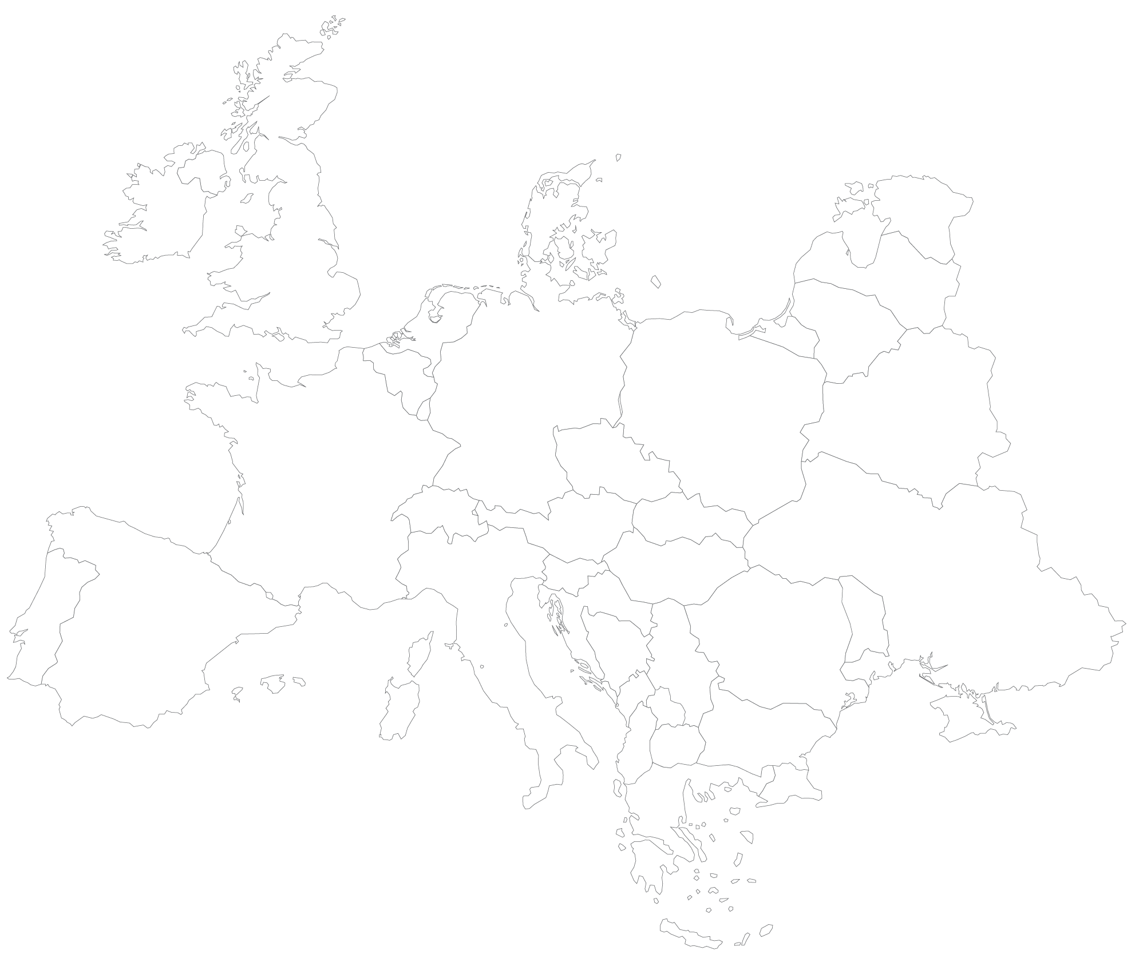



















The OPTIMATE consortium
Denmark
United Kingdom
Belgium
1 Coordinator
5 Transmission System Operators
6 Research units
Belgium
germany
germany
Technical director
france
Coordinator
france
france
spain
italy
spain

Slide 6
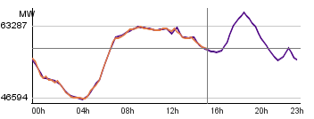
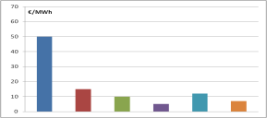
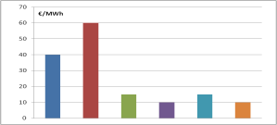
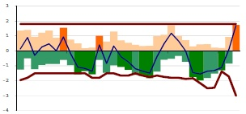


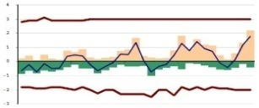
General principle of OPTIMATE
Architecture nº1
OPTIMATE
Given
€
Optimal Vision (LT)
Simulation
Optimate Vision (ST)
The recommended architecture is
OPTIMATE
Architecture nº1
Architecture nº2

Slide 7
Current status of OPTIMATE
Outputs of the FP7 project = Prototype
  Public platform optimate-platform.eu with access granted to external users having a licence
    Target: ENTSO-E members, Energy Regulators, Academics, Public Entities (and experts mandated by these entities)
  Training sessions regularly scheduled
  → Next session: 19 to 22 May in Paris area
Further functional development and industrialization of the platform are ongoing
  Out of the scope of Market4RES

Slide 8
Tasks in Market4RES WP4
New market design options to be studied quantitatively
  Data upgrade
    Geographic scope
    2020 horizon
  Generation units aggregation
  Full year modelling
  Scope of scenario options
    Levels of RES penetration
    RES support schemes
    Demand-side flexibility
    Cross-border capacity management
    …
Scenario generation
  Formatting the chosen options as inputs of OPTIMATE

Slide 9
Tasks in Market4RES WP4
Benefit validation of the tested options using OPTIMATE
  For each option studied, performance indicators will be delivered by OPTIMATE:
Indicator group | Examples
Efficiency | Social welfare Generation costs Market prices
Redistributive effects | Split of social welfare among Market areas Consumers and producers Congestion revenue
Security of supply | Day-ahead reserves contracting
Renewable & Carbon | Share of RES-E CO₂ output

Slide 10
Tasks in Market4RES WP4
Recommendations for effective regulations and remuneration regimes of the quantified options
  Identification of measures compatible with the existing Target Model promoting the best solutions with regards to the short-run optimization of assets

Slide 11
Tasks in Market4RES WP4
Expert workshop and consultation
  Expert-Workshop focused on the identification of the options to be studied with OPTIMATE, based on preliminary specifications provided by WP4 partners
BRUSSELS
MARCH 2015
  Consultation Process & Stakeholder-Event
    Written consultation to collect stakeholders’ opinions and suggestions regarding the options to be studied based on preliminary specifications provided by WP4 partners
    Final specifications and preliminary results of simulations discussed at a stakeholder event
NICE
SEPT. 2015

Slide 12
Thank you for your attention
Sophie Dourlens-Quaranta
sdourlens@symple.eu
Office: +33 4 93 65 34 44
Mobile: +33 6 88 25 15 02

