Slide 1
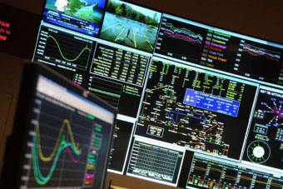
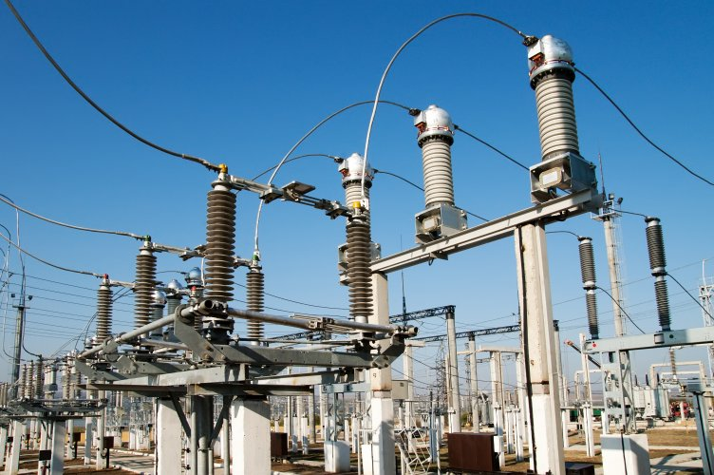
Market4RES WP5: Modelling of electricity market design & Quantitative evaluation of policies for post 2020 RES-E targets Peter Ahcin peter.ahcin@sintef.no www.sintef.no/energy
Photos: Shutterstock, KeyTex
Stakeholder Kick-off Workshop, IEE-Market4RES, Brussels, 2014-04-28

Slide 2
WP5 objective
As current RES support schemes are phased out after 2020 new kinds of market mechanisms will have to be implemented that will in accordance with the EU energy policy:
Promote a competitive market with large shares of renewables and without support mechanisms
Guarantee security of supply by providing market incentives to invest in generation
WP5 will define a framework in which the effectiveness of market mechanisms regarding the above goals can be studied and provide the first results.

Slide 3
WP5 task description
Task 5.1 (RTE, SINTEF, IIT-COMILLAS) Assumptions for the defined market design elements to be taken into account for the techno-economic analyses of new policies
Regulatory provisions pertaining to the energy transition Describe support schemes for RES from WP2&WP3 Determining relevant incentives for low carbon non-RES technologies Capacity markets Cross-border or national Technology specific or neutral Tender based Regulatory provisions for demand side management

Slide 4
WP5 task description
Task 5.2 (RTE, SINTEF, TECHNOFI) Identification of scenarios to be tested for the techno-economic analyses of new policies
Defining (limiting) the scope of economic studies to be performed Coordination with WP3 to define the research questions for techno-economic analyses and modeling Select the relevant regulatory provisions Establishing base cases (coupled day-ahead markets, but different capacity markets) Identifying the required data to perform numerical simulations and data sharing regimes

Slide 5
WP5 task description
Task 5.3 (SINTEF, RTE, IIT-COMILLAS, EEG) Identification of models used for quantification
Discussion of all participants' models; will require long term investment models or long term load-supply models. Discussion on which models should be used to study which policies. Will include tools used in WP4 Intense interaction with WP3 to determine how different policies can be studied with the use of available models If no model is available simple models will be developed.

Slide 6
Available models
EMPS model (SINTEF Energy Research)
CEO Model (IIT-COMILLAS)
ROM (IIT-COMILLAS)
MILLA-RES (IIT-COMILLAS)
MITHRAS (EEG)
RTE MODELS (RTE)
Hydropower scheduling used in Nordic market.
(also El. Certificates and capacity development.)
Input: details for hydro & other RES, thermal gen., demand, transmission capacity and statistics for stochastic variables.
Data: available for Nordic area. Will need to be updated for required future scenarios.

Slide 7
Available models
EMPS model (SINTEF Energy Research)
CEO Model (IIT-COMILLAS)
ROM (IIT-COMILLAS)
MILLA-RES (IIT-COMILLAS)
MITHRAS (EEG)
RTE MODELS (RTE)
Long-term generation expansion model to perform analyses of generation adequacy
Input: installed capacity and tech. data, inv., fuel and CO2 costs, RES and demand growth scenarios.
Output: Newly installed thermal capacity, power generation by tech, CO2 ems, system costs.
Data: available for Spanish system up to 2050. Partners to fill in for other regions.

Slide 8
Available models
EMPS model (SINTEF Energy Research)
CEO Model (IIT-COMILLAS)
ROM (IIT-COMILLAS)
MILLA-RES (IIT-COMILLAS)
MITHRAS (EEG)
RTE MODELS (RTE)
Technical and economic impact of intermitent generation and other types of emerging technologies
Input: Hourly RES production, thermal gen. capacity, weekly hydro gen., hourly demand, transfer capacity.
Output: output per tech. and area, energy not served, RES spillages per area, market prices.
Data: available for Spanish system up to 2050. Partners to fill in for other regions.

Slide 9
Available models
EMPS model (SINTEF Energy Research)
CEO Model (IIT-COMILLAS)
ROM (IIT-COMILLAS)
MILLA-RES (IIT-COMILLAS)
MITHRAS (EEG)
RTE MODELS (RTE)
Evaluate impact of intraday and reserve market design on integration of intermittent generation.
Input: Hourly RES forecasts, thermal gen. capacity, hydro inflows, hourly demand.
Output: generation by tech., RES curtailment, use of balancing, operation costs.
Data: available till 2020 for Iberian peninsula. Partners to fill in for other regions.

Slide 10
Available models
EMPS model (SINTEF Energy Research)
CEO Model (IIT-COMILLAS)
ROM (IIT-COMILLAS)
MILLA-RES (IIT-COMILLAS)
MITHRAS (EEG)
RTE MODELS (RTE)
NPV based model that estimates the competitiveness of photovoltaic systems;
Applicable to household, commercial, tertiary and industrial sector;
Available data: solar irradiance measured and standardized profiles; projected costs of PV systems. To be updated within project.

Slide 11
Available models
EMPS model (SINTEF Energy Research)
CEO Model (IIT-COMILLAS)
ROM (IIT-COMILLAS)
MILLA-RES (IIT-COMILLAS)
MITHRAS (EEG)
RTE MODELS (RTE)
ANTARES-based models for long-term economic equilibrium; reveal needs for capacity.
Investment dynamics model; show how market architecture will drive actors.
Available data: solar irradiance measured and standardized profiles; projected costs of PV systems. To be updated within project.

Slide 12
WP5 task description
Task 5.4 (IIT-COMILLAS, SINTEF, EEG) Simulations of the effects on the preselected scenarios
Scenarios will be evaluated with links with the policies and market-structures as proposed by WP3. This will be done using the following options Existing numerical tools for the European power market Smart use of model Case-specification Numerical illustrations of principle small-scale models

Slide 13
WP5 task description
Task 5.5 (SINTEF, RTE, IIT-COMILLAS, EEG, TECHNOFI)
Expert workshop and follow-up stakeholder consultation process & stakeholder-event
Expert-Workshop: interaction with ACER and national regulators, as well as policy makers, DG Energy and ENTSO-E. (D5.1 Assumptions, scenarios and models)
BRUSSELS
JUNE 2015
Stakeholder Workshop: discussion of final results. (D5.2 Quantitative evaluation of policies for post 2020 RES targets)
BRUSSELS
FEB. 2016

Slide 14
Deliverables
D5.1 Report on assumptions, scenarios and choice of models for quatification (RTE M18)
D5.2 Report on quantitative evaluation of policies for post 2020 RES-E targets (SINTEF, M24)
D5.3 Minutes and recommendations of the expert workshop and follow-up consultation process & stakeholder event allocated to work in WP5 (SINTEF, M24)

Slide 15
Output
Description of overall methodology for techno-economic analysis of studied policies;
Comparison and impact of novel market designs and policies from WP3;
Interim report on possiblities and limitations for wxisting models available in project;
Interim report for each case-study of considered policies;
Publication of case-studies in conferences and journals

Slide 16
Example from EMPS work & Nordic Market
SINTEF is running a Norwegian project on modeling of the Green Certificates market arrangement for the Nordic market, e.g. trying to estimate the price of GC in future scenarios with high RES shares in the Nordic market.
We would like very much to explore how this GC scheme could extend to the Offshore Grid, direct coupling to IEE NorthSeaGrid project!
Enlarge the discussion on harmonization of market rules and market designs (for Offshore Grids and in general for the IEM).
Link the ongoing discussion of CWE Flow-Based Market Coupling and the (further) development – implementation of Network Codes post 2020 and with high RES shares in 2030.

Slide 17
Harmonization of market rules and market designs
Enlarge the discussion on harmonization of market rules and market designs (for Offshore Grids and in general for the IEM).
Link the ongoing discussion of CWE Flow-Based Market Coupling and the (further) development – implementation of Network Codes post 2020 and with high RES shares in 2030.

Slide 18
Mithras
NPV-based economic trade-off analyses of PV generation in all sectors (households, commerical/industry, utility-scale, non-grid connected)
Using real (measured) load profiles data and also standardized load profiles on an
1/4 –hourly basis
All parameters in the GUI can be edited/varied by user (tailor-made individual PV project analysis incl. sensitivity analysis possible)
Monte-Carlo simulation of all parameters implemented (mean value, standard deviation, lower/upper limit)
Optimisation of size of individual PV system fulfilling different criteria/constraints (e.g maximizing self consumption, economic benefits, etc.)
Identification of „expected“ market electricity price for feeding excess PV generation into the grid (incl. corresponding economic trade-offs) to meet some predefined economic criteria
Developed within the IEE project www.pvparity.eu
Application so far: 12 European Countries (AT, BE, CZ, DE, EL, ES, FR, IT, NL, PT, UK)

Slide 19
Tools
CEO
Role in Market4RES: computation of the optimal deployment of conventional generation given RES generation penetration objectives
Input: installed capacity and tech. data, inv., fuel and CO2 costs, RES and demand growth scenarios
Output: Newly installed thermal capacity, power generation by tech, CO2 emissions, system costs
Other EU projects: SUSPLAN
National projects:
CENIT-GAD: economic and regulatory analysis of DSM;
Prospective analysis of RES generation
Competitiveness of nuclear power plants (Energy Economics)

Slide 20
Tools
MILLA-RES
Role in Market4RES: Evaluate short-term (intraday and balancing) market designs on integration of intermittent generation
Input: Hourly RES forecasts, thermal gen, capacity, hydro inflows, hourly demand
Output: generation by tech., RES curtailment, use of balancing, operation costs
New model: no previous experience with it

Slide 21
Tools
ROM
Role in Market4RES: simulation of the short-term operation of a system, possibly considering several network areas
Input: Hourly RES output and demand time series, weekly hydro output time series, thermal gen. capacity, unit production costs, technical features of units
Output: operation costs, generation by each unit, RES curtailment, market prices, use of balancing reserves
Other EU projects: SUSPLAN, TWENTIES, MERGE, GRIDTECH
National projects: CENIT-VERDE

