Slide 1
Kick-off Consortium Meeting IEE-EU Market4RES
Frauke Thies
Policy Director, EPIA
5th Annual European Power Summit - 29 April 2014

Slide 2
Improving liquidity and flexibility in Europe’s power market
PV forecasting in a high fog situation: error of 8,000 MW for Germany
Final PV Intraday forecast very close to real-time projection
Due to limited ID-market liquidity, not all positions could be closed (max. 445 MW on 5 April 2013)
Day-ahead forecast Final ID-forecast Real-time projection Open positions
Source: Elia group

Slide 3
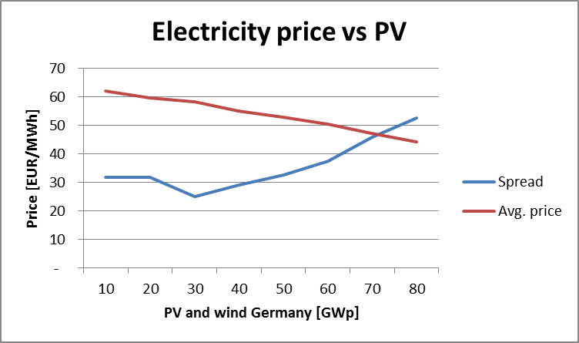
Investments in a market of declining prices?
Source: Meteotest

