Slide 1
Post 2020 framework in a liberalised electricity market with large share of Renewable Energy Sources
IEE-EU Market4RES
Brussels, 28th April 2014
Juan Bogas
OMIE. Iberian Market Operator

Slide 2
INTRODUCTION
Are the wholesale markets affected by the increase of RES?
Few quantity of RES; nothing happens.
Moderate quantity of RES; changes in the participant’s strategy. The market must be able to offer solutions. Changes in ancillary services.
Huge quantity of RES; The market must be able to offer solutions. Market must be close to real time.
How can organized markets incorporate demand-response offers?
Move the day-ahead prices to the demand.

Slide 3
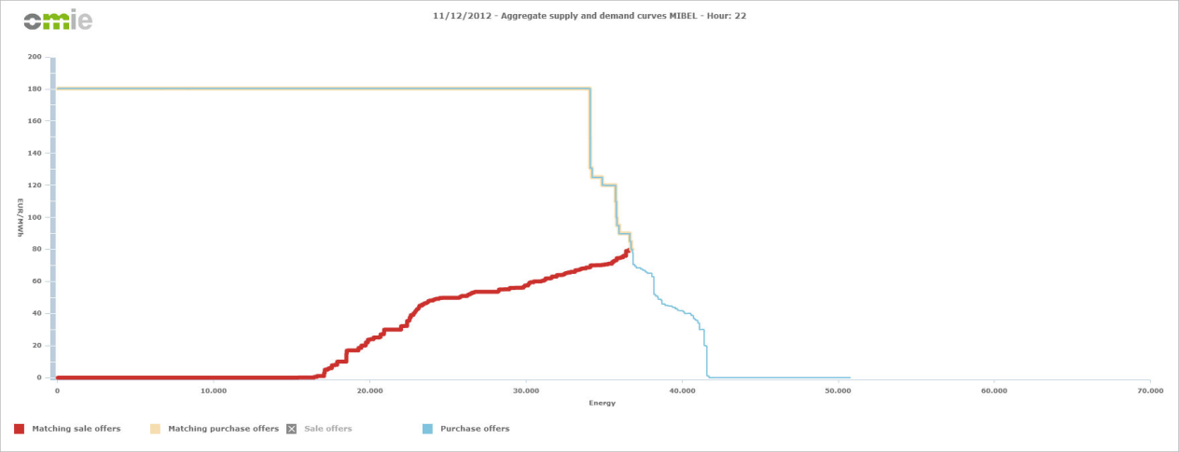
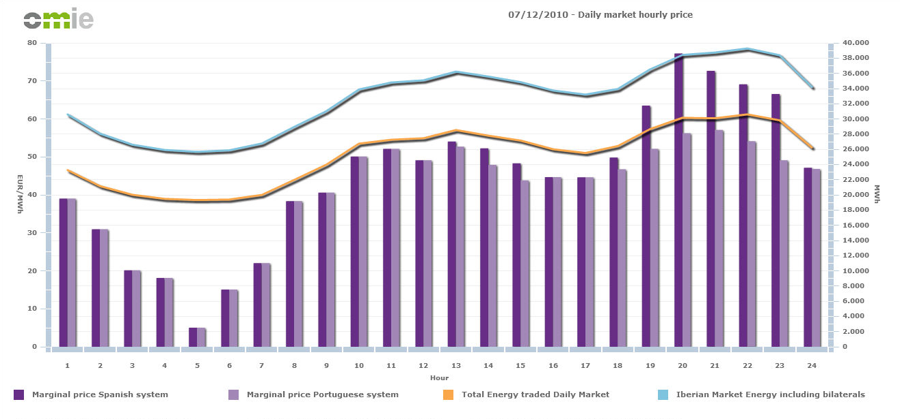
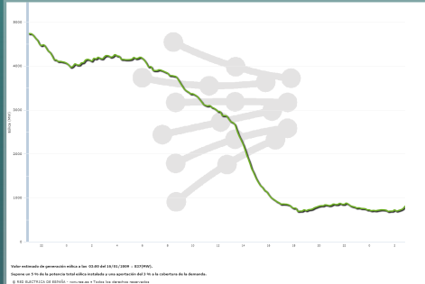
Few quantity of RES; nothing happens,…, prices decreases
Moderate quantity of RES; changes in the participant’s strategy. The market must be able to offer solutions: complex bids.
Additional problems; reserve

Slide 4
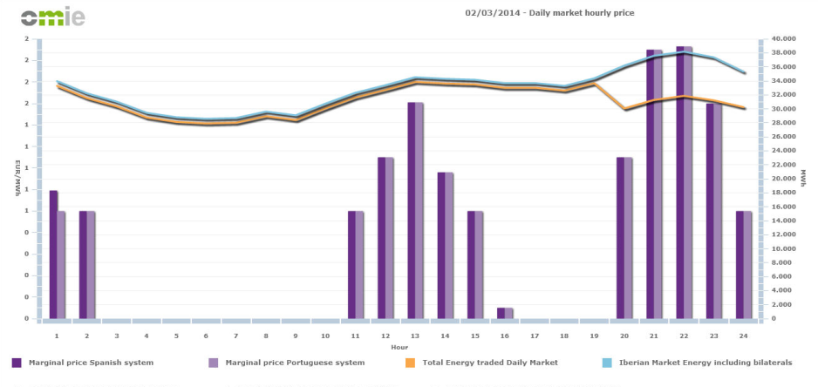
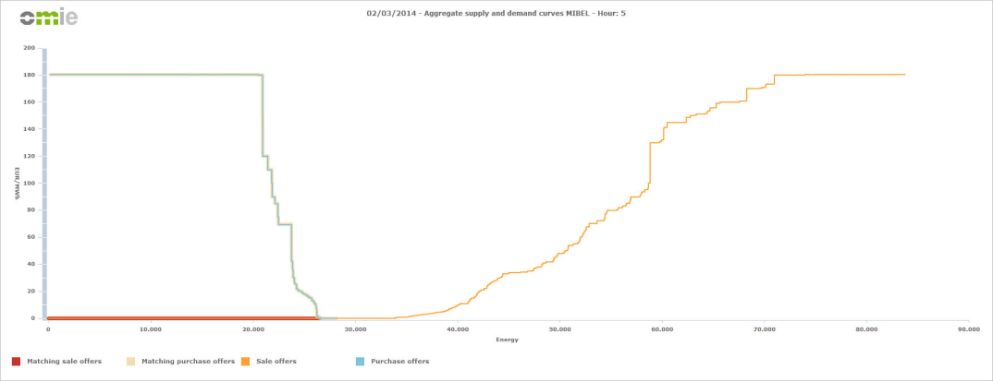
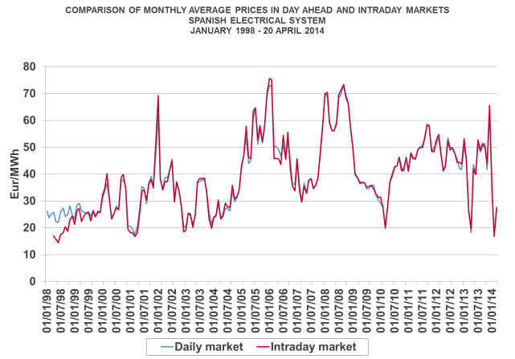
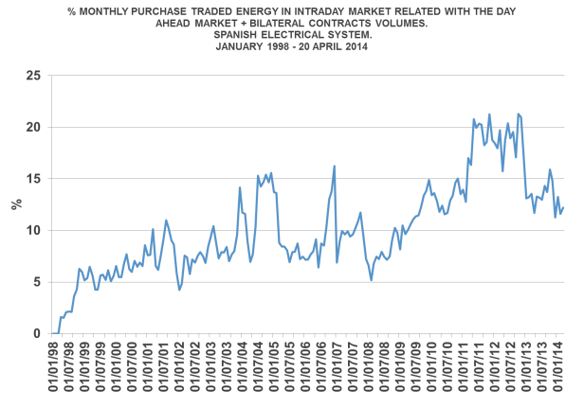
Huge quantity of RES; The market must be able to offer solutions. Market close to real time.
Intraday market; A transparent market, close to real time. Open to all kind of participants.
How can organized markets incorporate demand-response offers?
Move the day-ahead prices to the demand. Not only to big consumers, even domestic consumers.

